Slide 1
I/O Systems Lesson 2 Application I/O Interface
David Liu
Fall 2021

Slide 2
Application I/O Interface
I/O system calls encapsulate device behaviors in generic classes
Device-driver layer hides differences among I/O controllers from kernel
New devices talking already-implemented protocols need no extra work
Each OS has its own I/O subsystem structures and device driver frameworks
Devices vary in many dimensions
Character-stream or block
Sequential or random-access
Synchronous or asynchronous (or both)
Sharable or dedicated
Speed of operation
read-write, read only, or write only

Slide 3
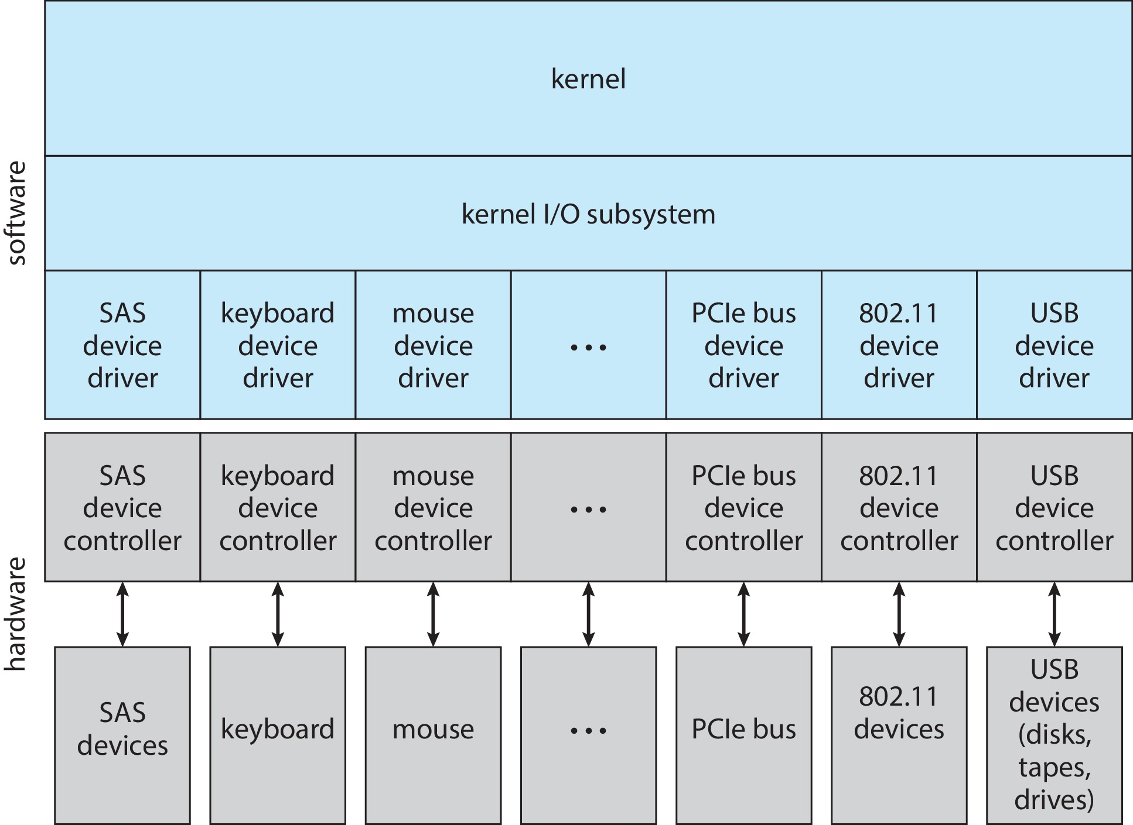
A Kernel I/O Structure

Slide 4
Characteristics of I/O Devices (Cont.)
Subtleties of devices handled by device drivers
Broadly I/O devices can be grouped by the OS into
Block I/O
Character I/O (Stream)
Memory-mapped file access
Network sockets
For direct manipulation of I/O device specific characteristics, usually an escape / back door
Unix ioctl() call to send arbitrary bits to a device control register and data to device data register

Slide 5
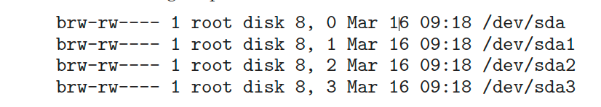
UNIX and Linux Device Numbers
UNIX and Linux use tuple of “major” and “minor” device numbers to identify type and instance of devices (here major 8 and minors 0-4) % ls –l /dev/sda*

Slide 6
Block and Character Devices
Block devices include disk drives
Commands include read, write, seek
Raw I/O, direct I/O, or file-system access
Memory-mapped file access possible
File mapped to virtual memory and clusters brought via demand paging
DMA
Character devices include keyboards, mice, serial ports
Commands include get(), put()
Libraries layered on top allow line editing

Slide 7
Network Devices
Varying enough from block and character to have own interface
Linux, Unix, Windows and many others include socket interface
Separates network protocol from network operation
Includes select() functionality
Approaches vary widely (pipes, FIFOs, streams, queues, mailboxes)

Slide 8
Clocks and Timers
Provide current time, elapsed time, timer
Normal resolution about 1/60 second
Some systems provide higher-resolution timers
Programmable interval timer used for timings, periodic interrupts
ioctl() (on UNIX) covers odd aspects of I/O such as clocks and timers

Slide 9
Nonblocking and Asynchronous I/O
Blocking - process suspended until I/O completed
Easy to use and understand
Insufficient for some needs
Nonblocking - I/O call returns as much as available
User interface, data copy (buffered I/O)
Implemented via multi-threading
Returns quickly with count of bytes read or written
select() to find if data ready then read() or write() to transfer
Asynchronous - process runs while I/O executes
Difficult to use
I/O subsystem signals process when I/O completed

Slide 10
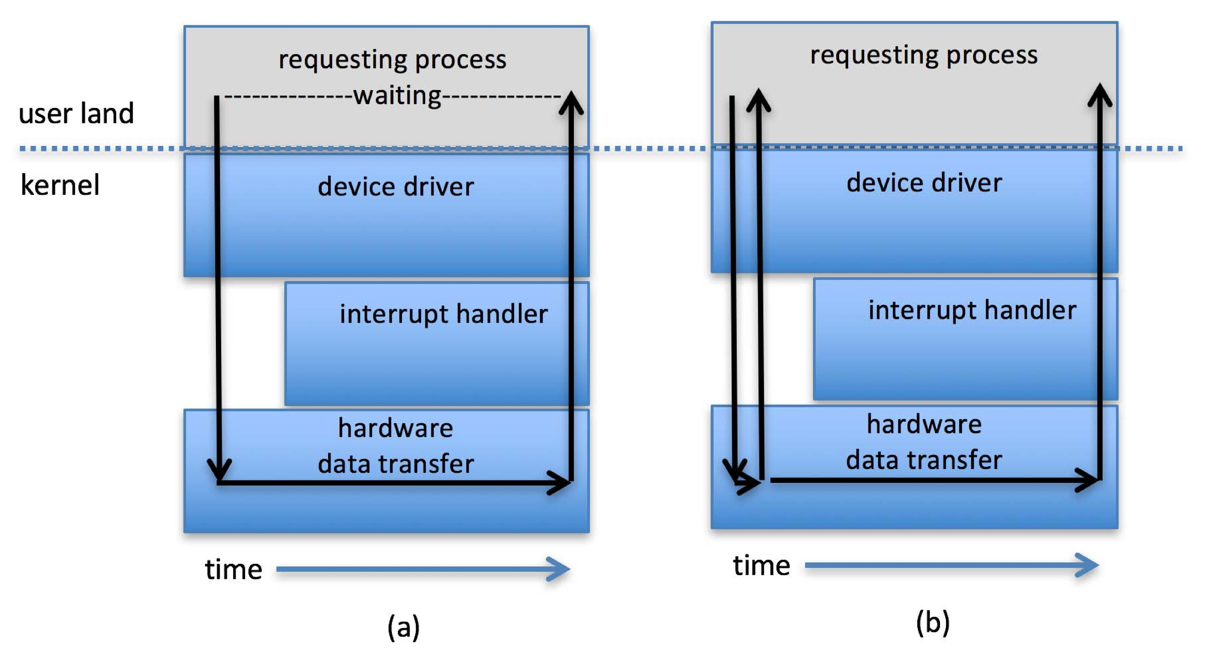
Two I/O Methods
Synchronous
Asynchronous

Slide 11
Vectored I/O
Vectored I/O allows one system call to perform multiple I/O operations
For example, Unix readve() accepts a vector of multiple buffers to read into or write from
This scatter-gather method better than multiple individual I/O calls
Decreases context switching and system call overhead
Some versions provide atomicity
Avoid for example worry about multiple threads changing data as reads / writes occurring

